Slide 1

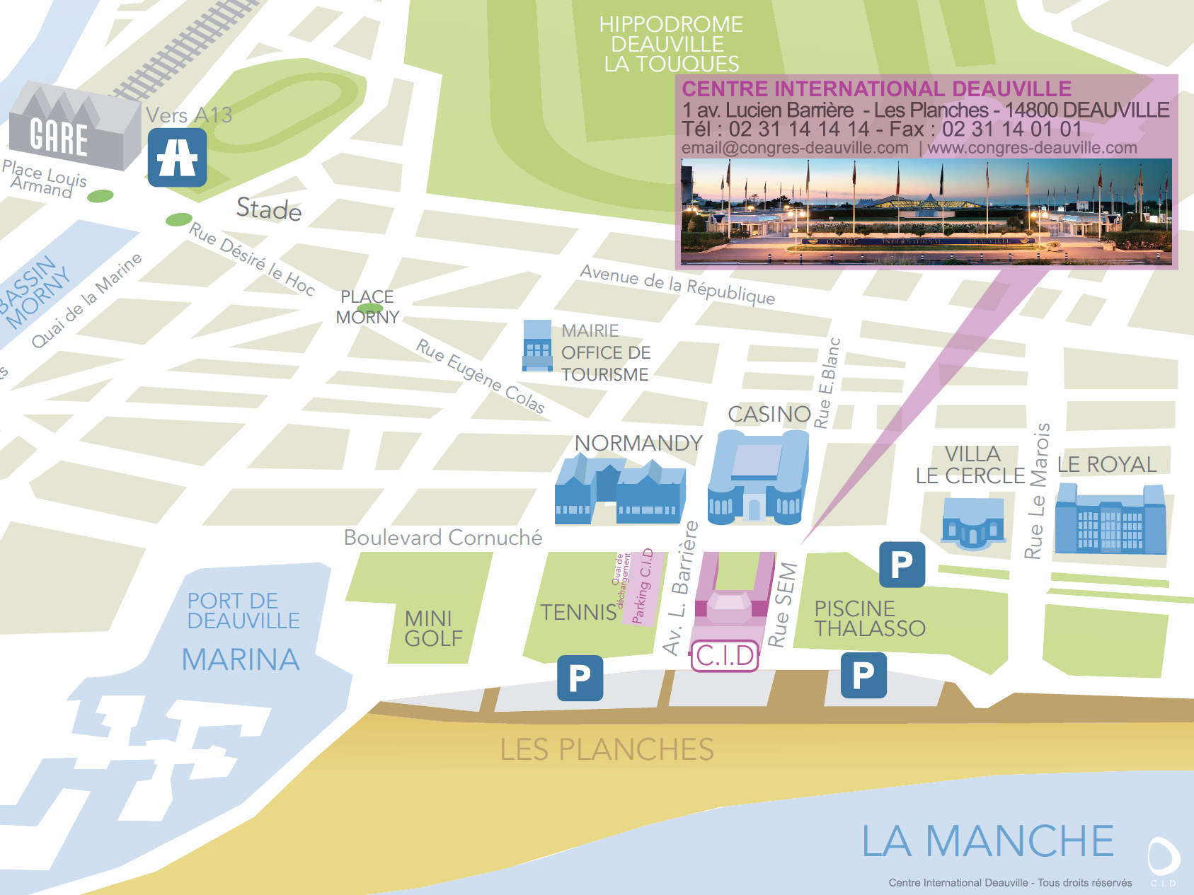



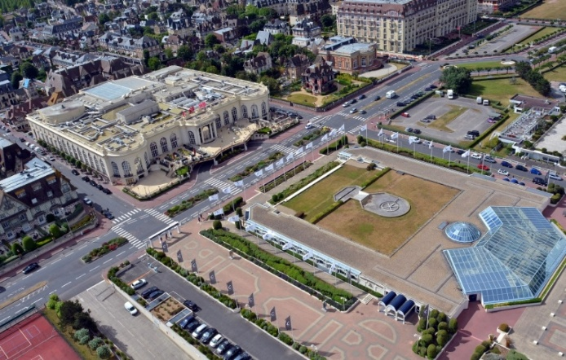
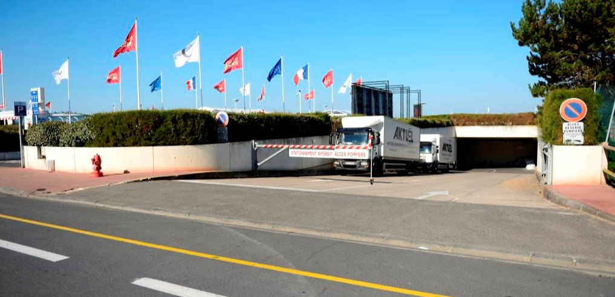
C.I.D
ACCESS
BY ROAD
2-hour journey from Paris.
Served from Paris by the A13 motorway
BY TRAIN
2h-hour journey from Paris Saint-Lazare station.
Direct links Paris Saint-Lazare/Deauville-Trouville Deauville-Trouville station 10 minutes’ walk away
BY PLANE
Deauville-St Gatien airport 10 minutes away
Caen-Carpiquet airport 45 minutes away
Le Havre-Octeville airport 45 minutes away
BY TAXI
Central Taxis de Deauville-Trouville : 02.31.87.11.11
AB Deauville Taxi : 06.84.22.04.32
Aaabn Taxi Viel Jérôme : 02.31.87.35.00
1 Boulevard Cornuché
2 Parking du Centre International Deauville
3 Accès quai de déchargement
4 Accueil administration
5 Rue Sem ; accès au parking des Lais de mer
5
1
4
3
2
ACCESS TO THE DELIVERY BAY C.I.D
Boulevard Cornuché, between the tennis courts and the C.I.D car park

Slide 2
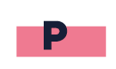
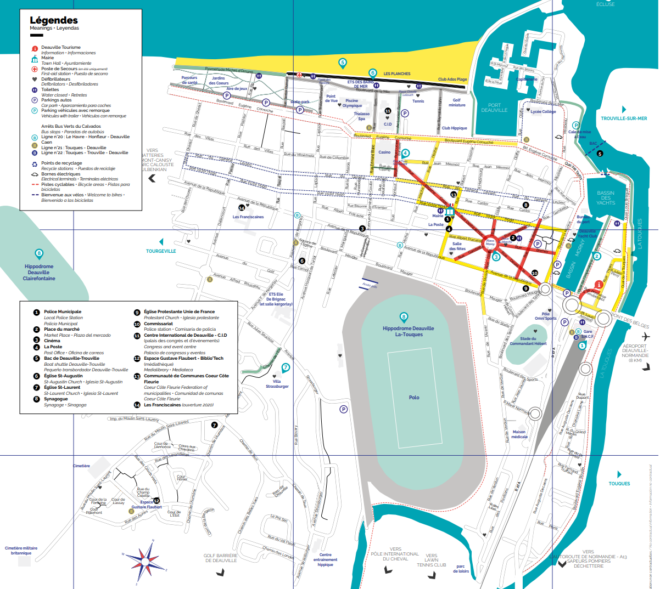
PARKING
2 MAIN PAY CAR PARKS
FOR LIGHT VEHICLES SURROUND THE C.I.D
The C.I.D car park : 69 spaces including 3 PRM spaces
Lais de Mer car park on Boulevard de la Mer : 1 000 spaces / 5 minutes’ walk from the C.I.D
Stationnement à Deauville

